Slide 1
Computer architecture
Final project presentation
Ramin Fahimi
Vahid Kharazi

Slide 2
Title:
Design & implement
4-Bit ALU

Slide 3
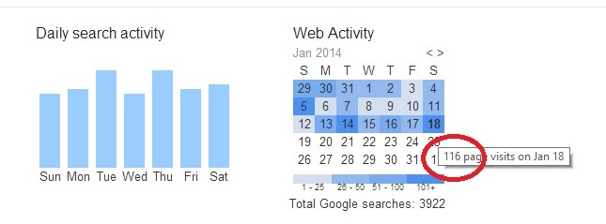
First step : Research!
Digging universities website

Slide 4
VHDL(VHSIC Hardware Description Language)
Features :
Ease of use
Dependent ( Verilog ?)
Behavior-based design
Concurrent, reactive ->dataflow model
File operation
…

Slide 5
IDE – simulator
If you do not have lots of bandwidth and time to download :
{
Only use Design_vision!
}
Else :
{
watch next slide;
}

Slide 6
IDE – simulator
Xilinix ISE | Very slow! Lots of storage(25 Gb) Force close!!
Altera II | FPAG Based Not useful for simple syntesis
Design Vision | Soft and Easy Having better options for Power and time optimization

Slide 7
Synthesis tech
Goal : 22 nm
---→ it is not available for free !
☹

Slide 8

Synthesis tech
Challenge : 40 nm - .15 um
----→ available for non-commercial purpose
problem?!!
Project Deadline!

